Slide 1
NAPLE Sister libraries
NAPLE Virtual Assembly 2022

Slide 2
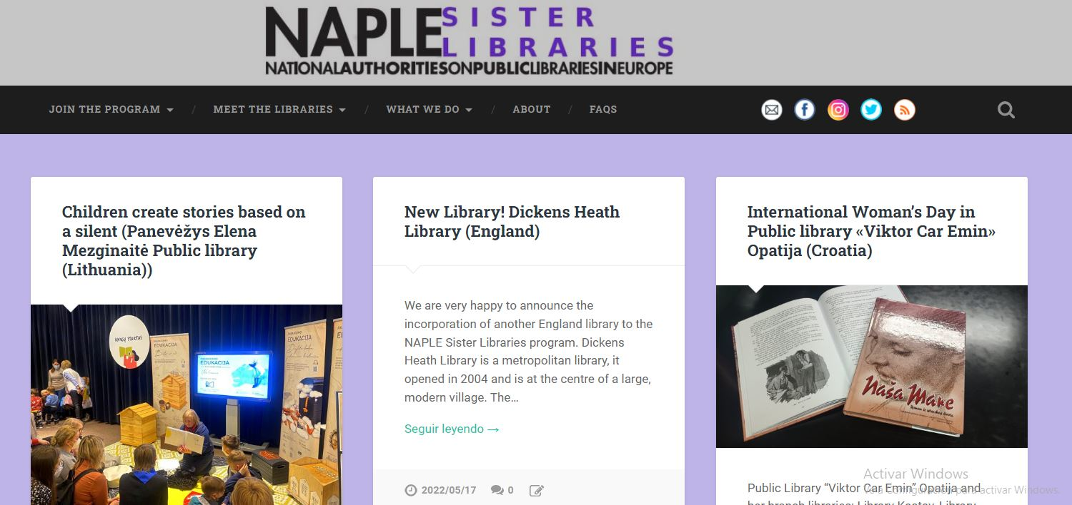

Slide 3
Statistics

Slide 4
More statistics

Slide 5
135 libraries (10 incorporations) from 18 countries (+1, England)
56 sisterships (+2)

Slide 6
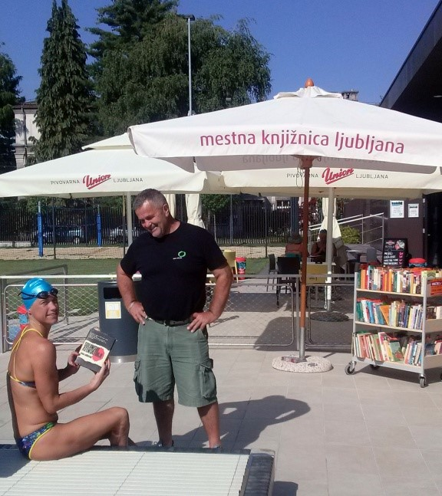
Summertime!

Slide 7
Thanks!
naple.sisterlibraries@gmail.com

