Slide 1
NAPLE Sister libraries

Slide 2
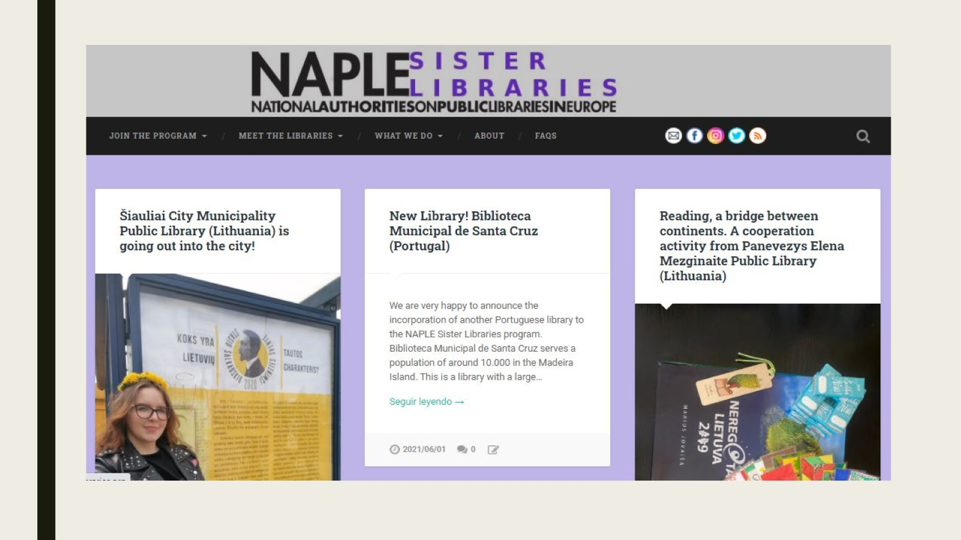

Slide 3
Statistics

Slide 4
More statistics

Slide 7
Summertime!

