Slide 1
NAPLE Sister libraries

Slide 3
What is Sister Libraries?

Slide 5
Country representatives

Slide 6
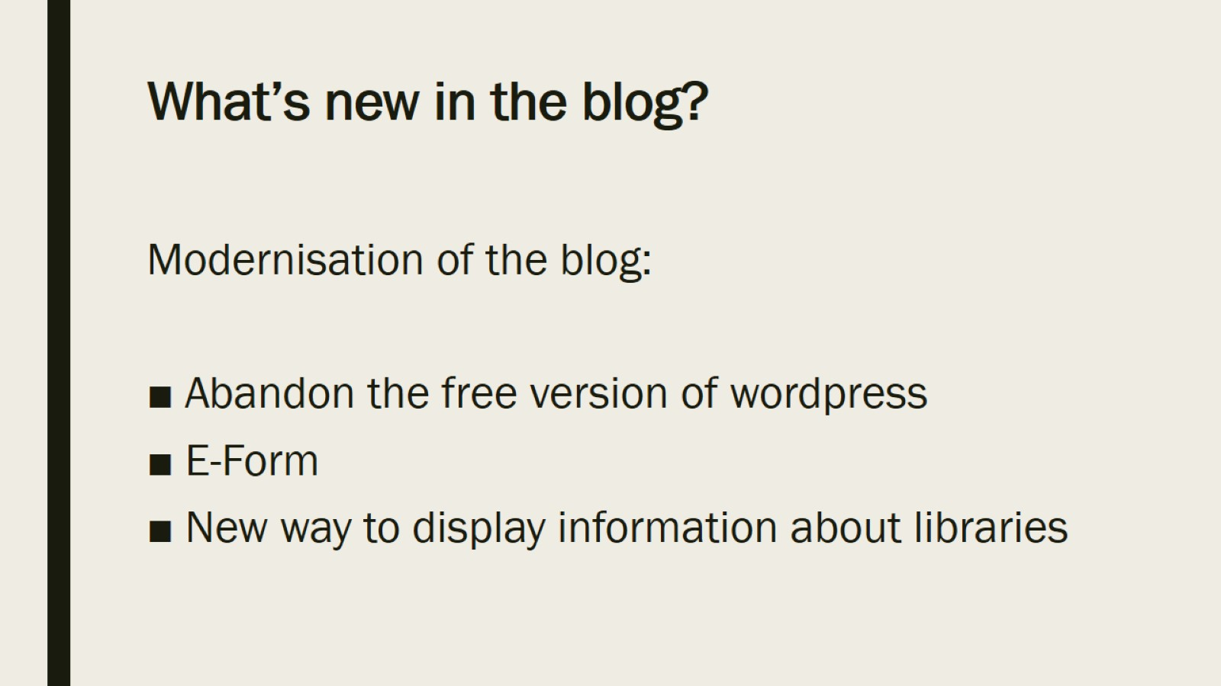
What’s new in the blog?

Slide 7
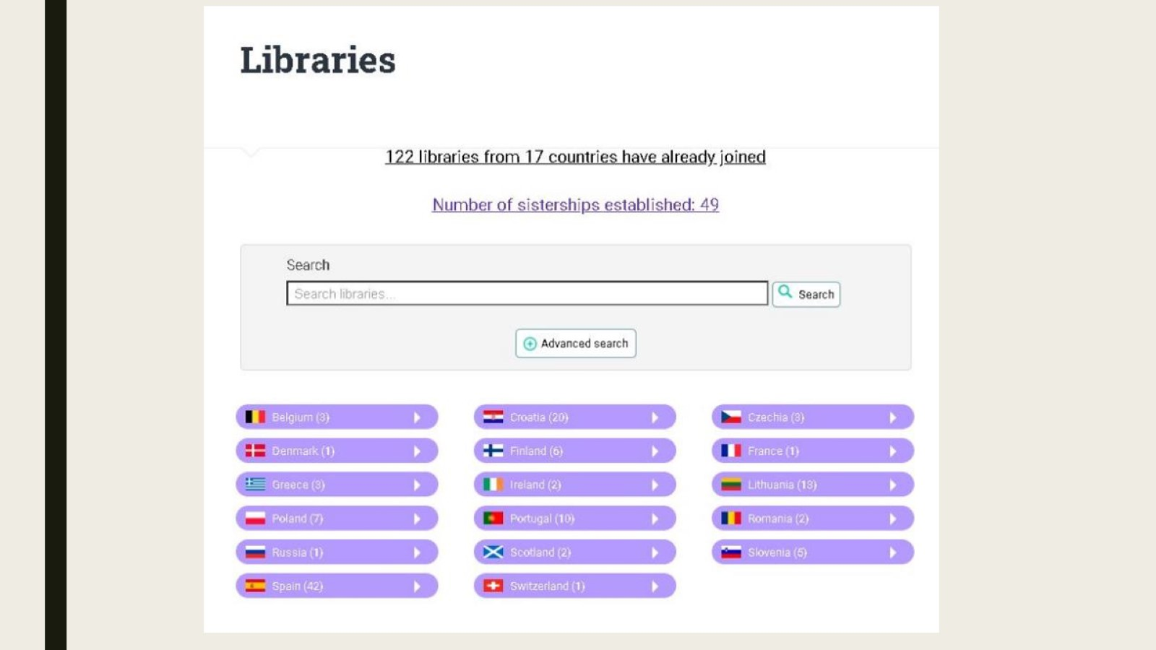

Slide 8
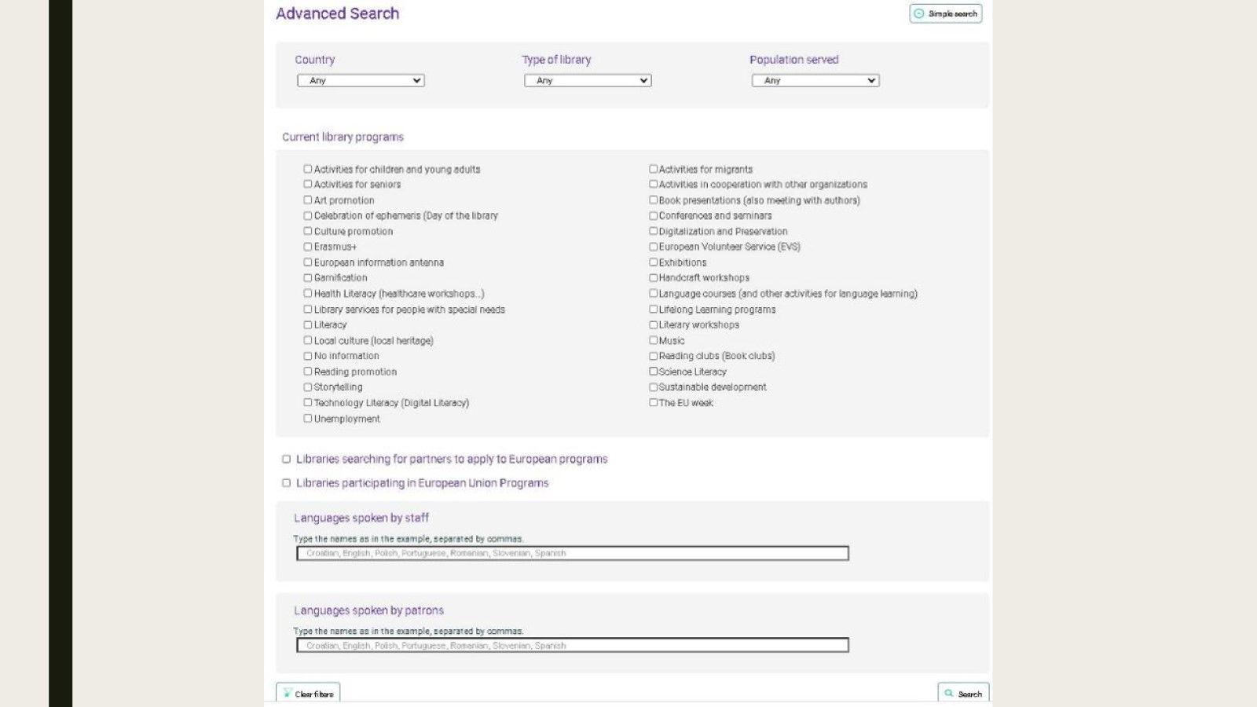

Slide 9
Statistics

Slide 10
More statistics

