Slide 1
NAPLE Sister libraries

Slide 3
Strategy: actions taken

Slide 4
Survey to improve NAPLE Sister Libraries

Slide 7
Figures

Slide 8
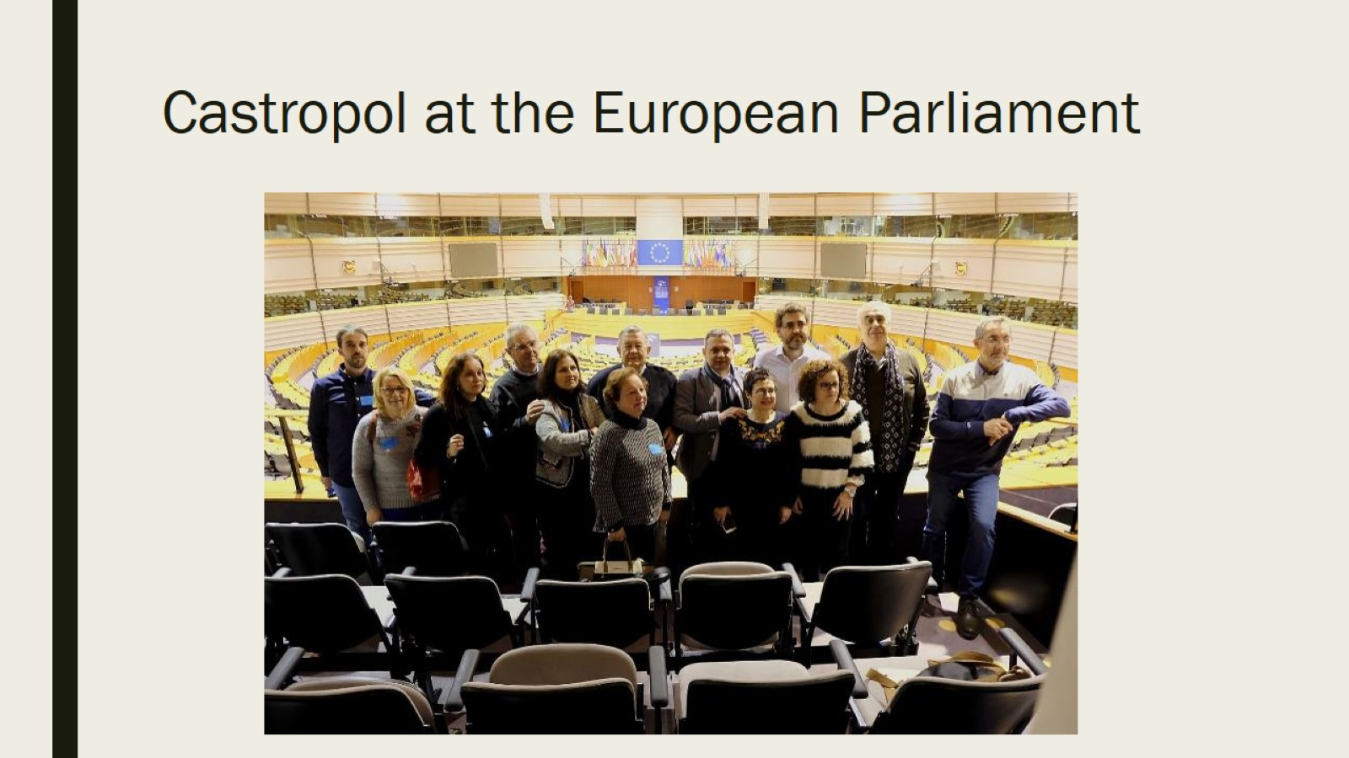
Castropol at the European Parliament

Slide 10
Proposal

