Slide 1
NAPLE SISTER LIBRARIES 2017
Update 2017
Statistics of Twitter and Blog
Communication Strategy
New Blog

Slide 2
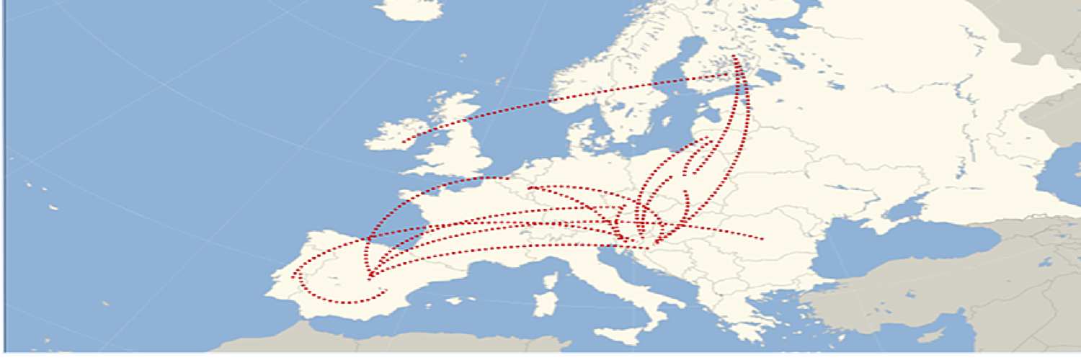
90 libraries from
16 countries- 1 new, Germany
37 Sisterships
671 Followers
700 visitors/month
Update 2016
month (Blog)
Why? Communication Strategy?

Slide 3
Statistics Twitter
Indicators |  | Dec. 2015 | Dec. 2016 | Feb. 2017 | March 2017 | April 2017
Profile details | Followers | 500 | 627 | 647 | 666 | 670
 | Tweets published | 28 | 100 | 127 | 126 | 124
 | Visits to the profile | 152 | 218 | 507 | 431 | 215
 | Tweet Impressions | 5.678 | 13,6K | 26,6K | 31,4K | 21,3K
Activity of the account | Average tweets/day | 1,02 | 4,55 | 6,49 | 5,12 | -
 | Activity: proportion of Tweets | 53% | 71,5% | 74% | 76,5% | -
 | Activity: proportion of Retweets | 46% | 28,5% | 26% | 23% | -
Technical quality | Usage of Hashtags | 58% | 72% | 67% | 68,5% | -
 | URL inclusion | 95,5% | 79,5% | 89% | 84% | -
 | Mentions | 54,5% | 52% | 54% | 50% | -
Influence | Tweets retweeted | 21% | 35% | 32% | 37% | -
 | Marked as Favourites | 14% | 34% | 28% | 34% | -
 | Included in lists | 29 | 74 | 81 | 82 | 82

Slide 4
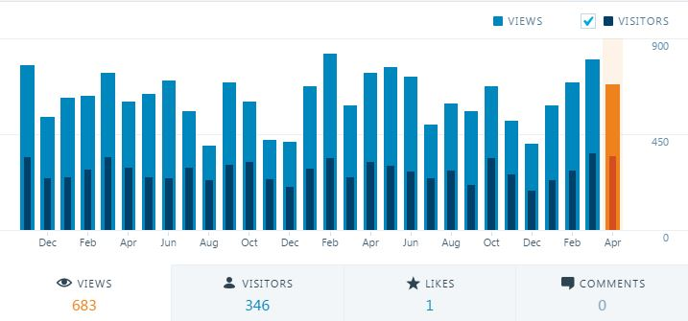
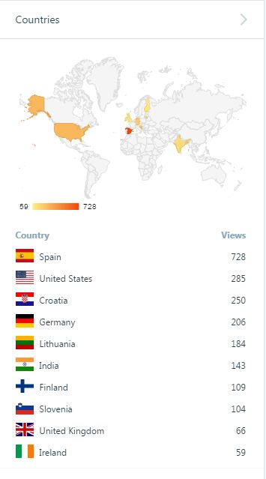
 | DIC 2016 | FEBRERO | MARZO | ABRIL
Visitas | 402 | 685 | 798 | 805
Visitantes | 182 | 276 | 359 | 404
Nºpost publicados | 1 | 2 | 2 | 3
Statistics Blog

Slide 5
Communication strategy
Focus on libraries, not national representatives
New Blog:
Simplified menu (redistribution of information)
Easier way to join the program (directly to Secretariat with eForm)
New logo, image linked to NAPLE (more corporate)

Slide 6
Thanks!
naple.sisterlibraries@gmail.com

