Slide 1
Update 2016
New Communication Strategy
Conclusions

Slide 2
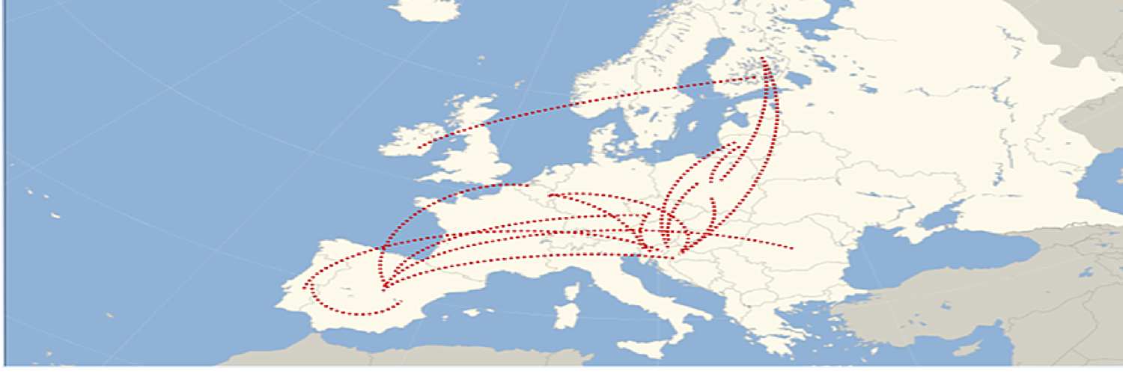
84 libraries from 14 countries 36 Sisterships
565 Followers
300 visitors/month
Update 2016
month (Blog)
Why? Communication Strategy?

Slide 3
To be relevant
By Offering high quality information
From Libraries & National Representatives
How?
A Fluent 2-Ways Communication
naple.sisterlibraries@gmail.com

Slide 4
Stats Blog

Slide 5
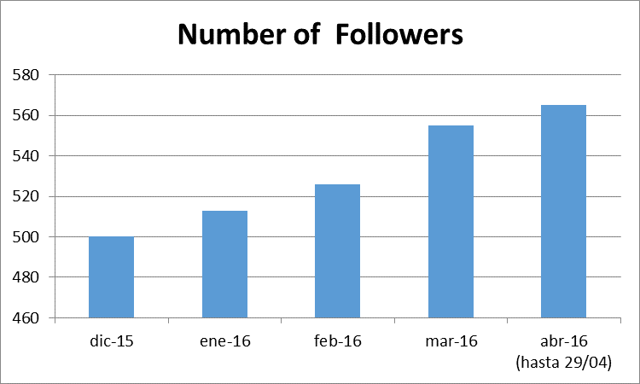
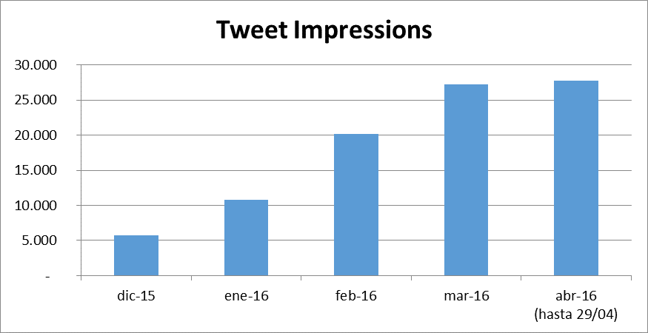
Stats Twitter

Slide 6
The new strategy can help
Sister Libraries, a tool for library cooperation?

Slide 7
THANKS!
naple.sisterlibraries@gmail.com

