Slide 2
MEMBERS
Substitutions:
Gunnel Stjernvall (Deputy Head of Communication and Digital Services
Public Programs @ National Library of Sweden) after Anna Lunden
Marit Vestlie (Strategic adviser National Library of Norway) after Svein Arne Tinnesand
Changes:
Inga Niedra and Kristīne Pabērza after Liga Kursite (Latvia)
Julija Mažuolienė (Lithuania). Moved to another job, no substitute yet.
Jos Debeij after Rianne Bowers (Netherlands)
Margarida Oleiro after Maarten Vandekerckhove as NAPLE Figures on European Public Libraries WG coordinator.
NAPLE WEBSITE

Slide 3
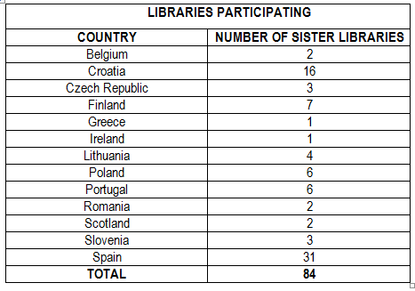
GENERAL FIGURES (data as of 30 April 2015)
84 libraries participating 13 countries/regions 34 sisterships working
6 New incorporations: 1 Czech Republic 4 Spain 1 Croatia

Slide 4
African proposal

Slide 7
Discussion
1. How do you feel about developing some kind of cooperation with Africa?
2. We believe this is a consolidated network. Can we make use of it?
3. Do you have further suggestions / proposals regarding Sister Libraries?

